Slide 1
CPR E 281: Digital Logic
Md Maruf Ahamed
Office: 307 Durham Center
Phone: (515) 294-6323
Email: maruf@iastate.edu

Slide 2
Administrative Stuff
  Homework: HW #03 due on Sunday @ 11:59 PM
  Quiz: Quiz #4 due on Friday @ 4:25 PM
  Recitation: Recitation #04 next week
  Lab: Lab # 04 next week
      Submit pre-lab prior to the lab otherwise you will lose 20% points
  Lecture-12 Readings: Section 2.17
  Verilog part 2: Posted on Canvas under lec 8
  Midterm 1: Friday, Feb 18
  Midterm 1 Samples: ( 2019 Exam)
  Midterm 1 bonus credit: Due before by Feb 18 @4:00pm

Slide 3
11–Functions and Circuits
  Strategy for Minimization
  Minimization of Sum-of-Products Forms
  Minimization of Product-of-Sums Forms
  Example: A circuit with multiple outputs
  Individual vs Joint optimization

Slide 4
Midterm 1 - Syllabus
  Lectures: Lec 01- Lec 12
  Homework: HW #00 ~ HW #04
  Quiz: Quiz #1 ~ Quiz #4
  Recitation: Recitation #01- 04
    Closed book
    No Calculator allowed
    You can use two pages (double sided) cheat sheet (printed or handwritten).

Slide 5

Midterm 1 - Topics
  Binary Numbers
  Octal Numbers
  Hexadecimal Numbers
  Conversion between the different number systems
  Truth Tables
  Boolean Algebra
  Logic Gates
  Circuit Synthesis with AND, OR, NOT
  Circuit Synthesis with NAND, NOR
  Converting an AND/OR/NOT circuit to NAND circuit
  Converting an AND/OR/NOT circuit to NOR circuit
  SOP and POS expressions
  Mapping a Circuit to Verilog code
  Mapping Verilog code to a circuit
  Multiplexers
  Venn Diagrams
  K-maps for 2, 3, and 4 variables
  Minimization of Boolean expressions using theorems
  Minimization of Boolean expressions with K-maps
  Incompletely specified functions (with don’t cares)
  Functions with multiple outputs

Slide 6
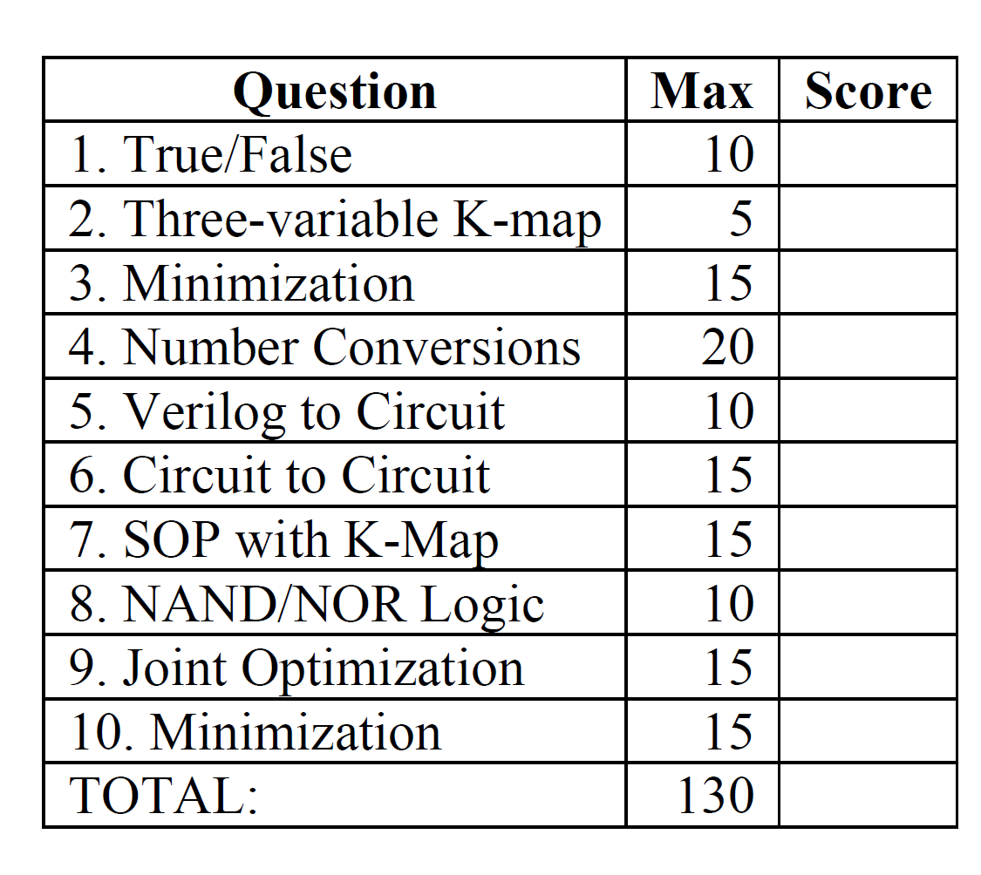
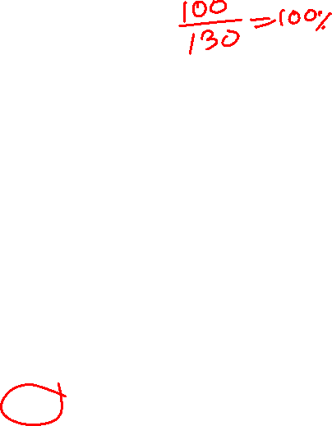
Midterm 1- sample outlines

Slide 7
Review

Slide 8

Terminology
  Literal: a variable (complemented or uncomplemented)
Implicant: product term that indicates the input combinations for which the function output is 1
Prime Implicant: Implicant that cannot be combined into another implicant with fewer literals
Essential Prime Implicant: Prime implicant that includes a minterm not covered by any other prime implicant
Cover: Collection of implicants that account for all possible input valuations where output is 1
x
1
x
2
x
3
00
01
11
10
$f=x_{2}+x_{1} \overline{x_{3}}+ {\overline{x}}_{1}x_{3}$
0
0
1
1
1
1
1
1
1
0

Slide 9
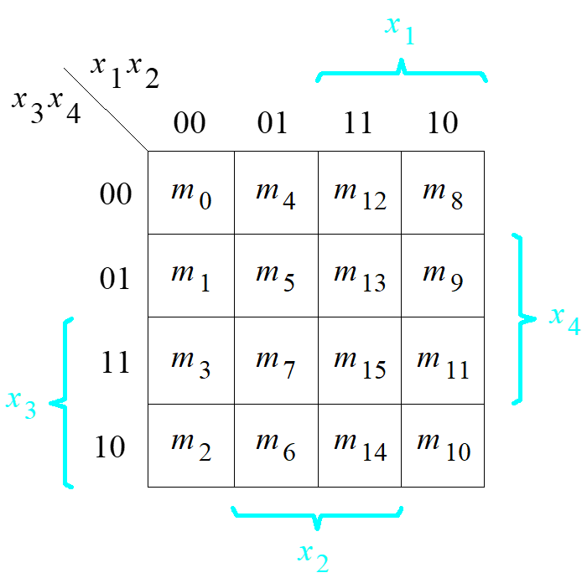




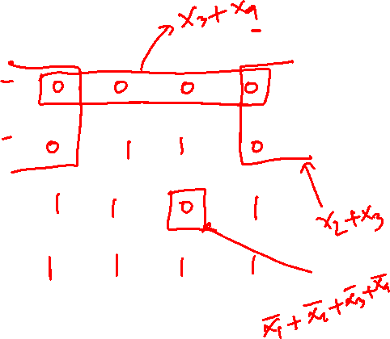


POS minimization of f ( x₁,…, x₄) = ∏ M(0, 1, 4, 8, 9, 12, 15)
x₁ x₂
x₃ x₄
00 01 11 10
00
01
11
10
[ Figure 2.61 from the textbook ]

Slide 10

SOP minimization of f ( x₁,…, x₄) = ∏ M(0, 1, 4, 8, 9, 12, 15)
x₁ x₂
x₃ x₄
00 01 11 10
00
01
11
10
[ Figure 2.61 from the textbook ]

Slide 11

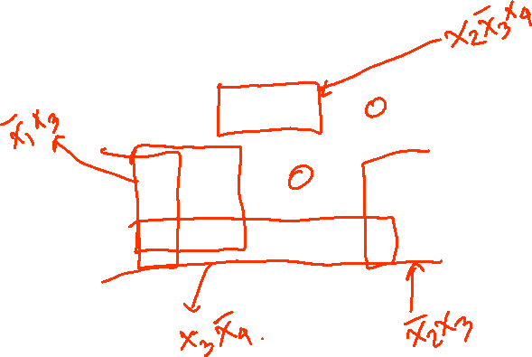
SOP minimization of f ( x₁,…, x₄) = ∏ M(0, 1, 4, 8, 9, 12, 15)
x₁ x₂
x₃ x₄
00 01 11 10
00
01
11
10
[ Figure 2.61 from the textbook ]

Slide 12
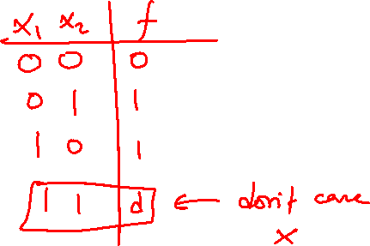
Example: Incompletely Specified Function

Slide 13
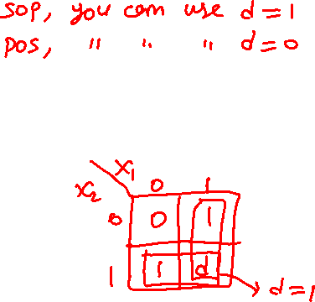
Example: Incompletely Specified Function
A function that has don’t-care condition(s) is said to be incompletely specified.
Since these input valuations will never occur, the designer may assume that the function value for these valuations is either 1 or 0, whichever is more useful in trying to find a minimum-cost implementation.
X₁ X₂ | f
0 0 0 1 1 0 1 1 | 0 1 1 d

Slide 14
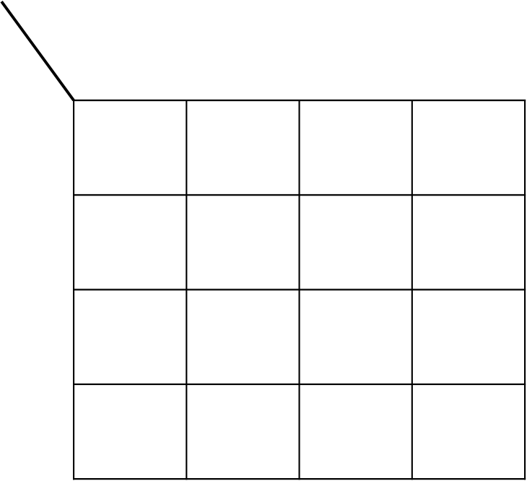
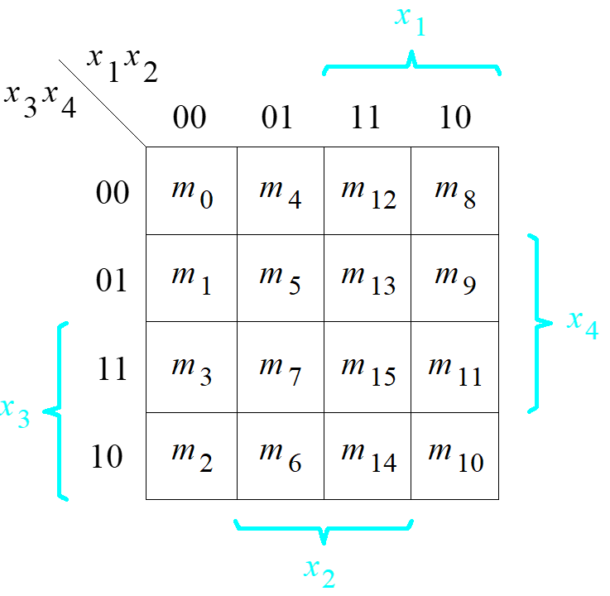
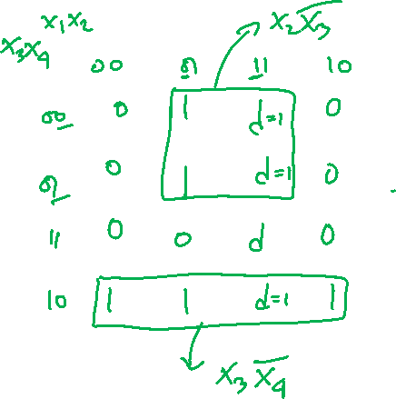
Three Ways to Specify the Function
f(x₁, x₂, x₃, x₄) = Σ m(2, 4, 5, 6, 10) + D(12, 13, 14, 15)

Slide 15
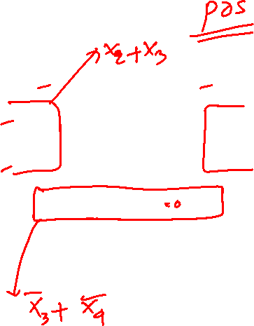
Three Ways to Specify the Function
f(x₁, x₂, x₃, x₄) = Σ m(2, 4, 5, 6, 10) + D(12, 13, 14, 15)
x
x
x
x
1
2
3
4
00
01
11
10
00
0
1
d
0
01
0
1
d
0
11
0
0
d
0
10
1
1
d
1

Slide 16
SOP vs POS implementation
x
1
x
2
x
3
x
4
00
01
11
10
00
0
1
d
0
01
0
1
d
0
11
0
0
d
0
f(x₁, x₂, x₃, x₄)
= Σ m(2, 4, 5, 6, 10) + D(12, 13, 14, 15)
10
1
1
d
1
x
1
x
2
x
3
x
4
00
01
11
10
00
0
1
d
0
01
0
1
d
0
11
0
0
d
0
10
1
1
d
1
[ Figure 2.62 from the textbook ]

Slide 17
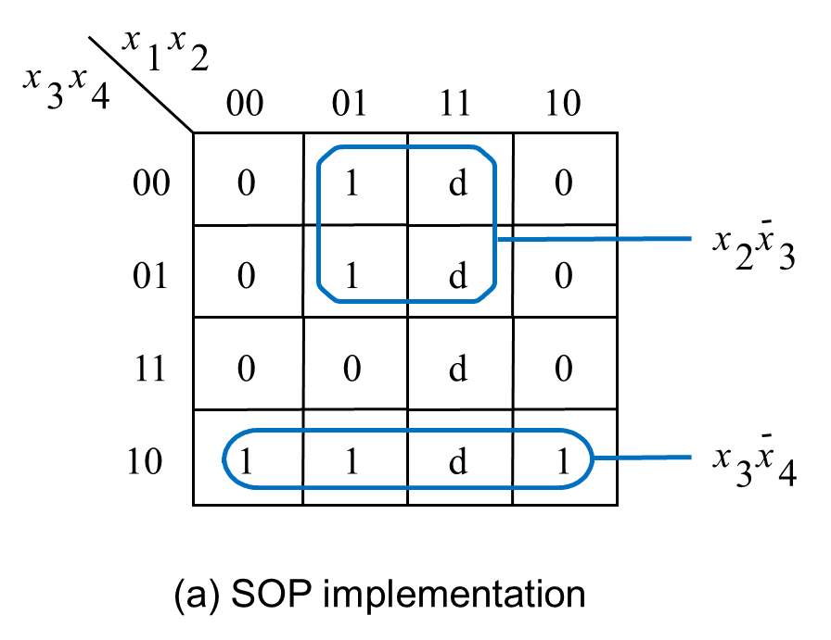

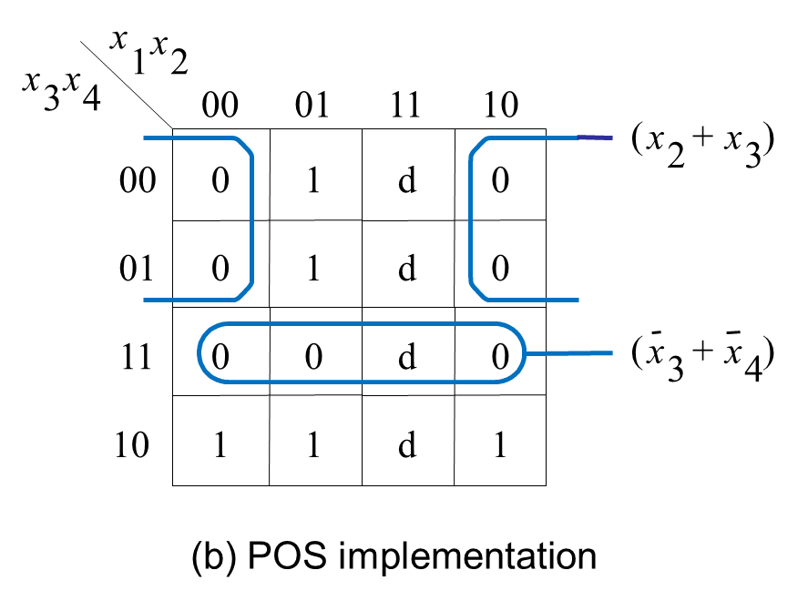

Example: Incompletely Specified Function
f(x₁, x₂, x₃, x₄) = Σ m(2, 4, 5, 6, 10) + D(12, 13, 14, 15)

Slide 18
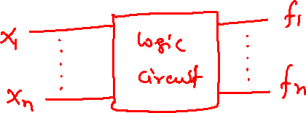
Example:
A circuit with multiple outputs

Slide 19
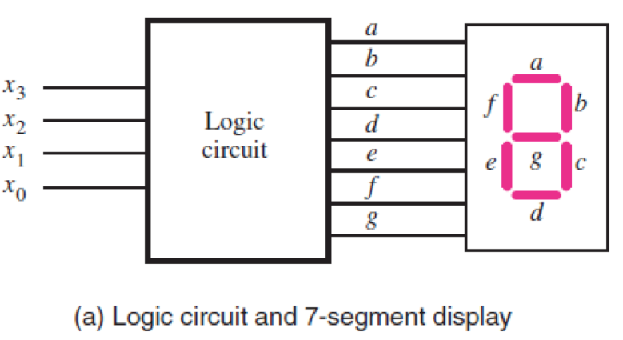
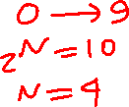
Seven-Segment Indicator

Slide 20
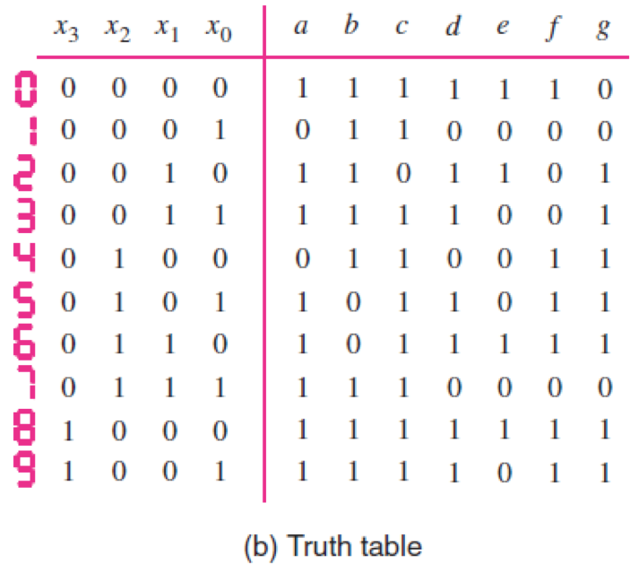
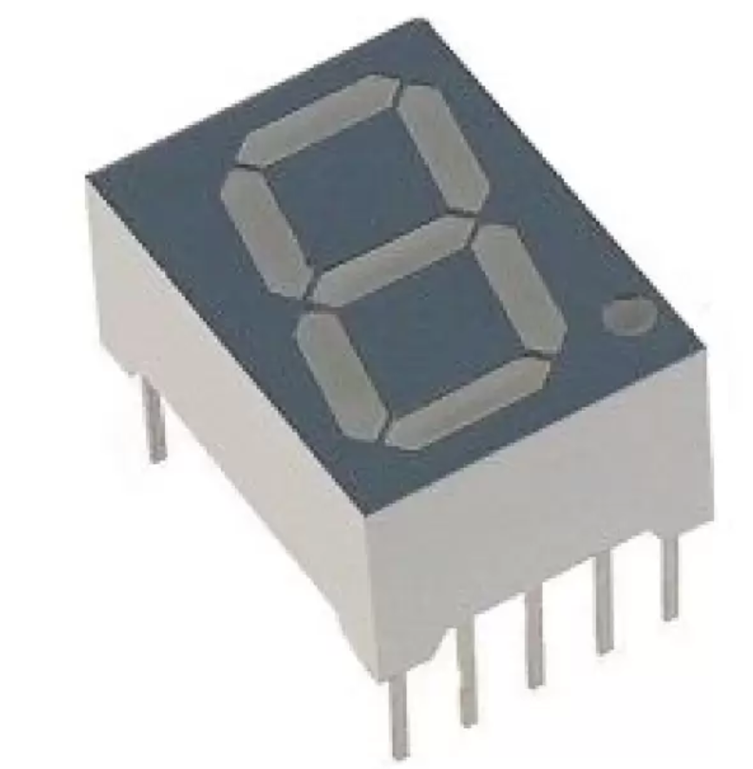
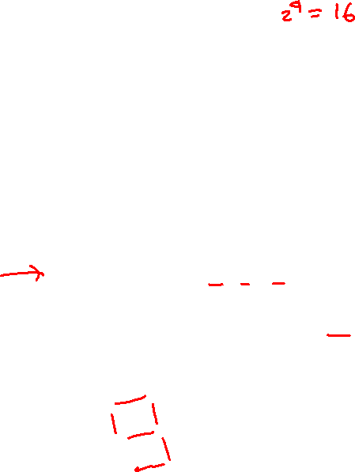
Seven-Segment Indicator

Slide 21
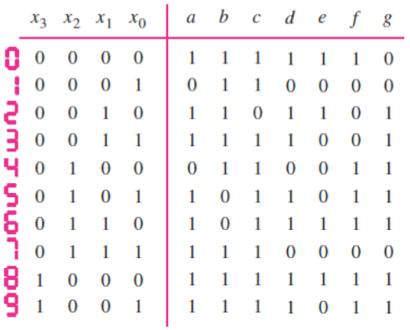
Seven-Segment Indicator
0 1 0
1 0 1 1
1 0 0
1 1 0 1
1 1 1 0
1 1 1

Slide 22
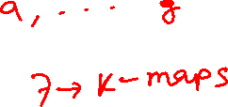
Seven-Segment Indicator
0 1 0
1 0 1 1
1 0 0
1 1 0 1
1 1 1 0
1 1 1
d d d d d d d
d d d d d d d d d d d d d d
d d d d d d d d d d d d d d
d d d d d d d

Slide 23
Seven-Segment Indicator
0 1 0
1 0 1 1
1 0 0
1 1 0 1
1 1 1 0
1 1 1
d d d d d d d
d d d d d d d d d d d d d d
d d d d d d d d d d d d d d
d d d d d d d

Slide 24

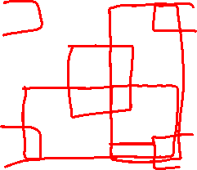
Seven-Segment Indicator
x
3
x
2
x
1
x
0
00
01
11
10
00
1
0
d
1
01
0
1
d
1
11
1
1
d
d
10
1
1
d
d
0 1 0
1 0 1 1
1 0 0
1 1 0 1
1 1 1 0
1 1 1
d d d d d d d
d d d d d d d d d d d d d d
d d d d d d d d d d d d d d
d d d d d d d

Slide 25
Seven-Segment Indicator
x
3
x
2
x
1
x
0
00
01
11
10
0 1 0
1 0 1 1
1 0 0
1 1 0 1
1 1 1 0
1 1 1
d d d d d d d
d d d d d d d d d d d d d d
d d d d d d d d d d d d d d
d d d d d d d
00
1
0
d
1
01
0
1
d
1
11
1
1
d
d
10
1
1
d
d

Slide 26
Seven-Segment Indicator
x
3
x
2
x
1
x
0
00
01
11
10
0 1 0
1 0 1 1
1 0 0
1 1 0 1
1 1 1 0
1 1 1
1 d d d d d d
1 d d d d d d
1 d d d d d d
1 d d d d d d
1 d d d d d d
1 d d d d d d
00
1
0
1
1
01
0
1
1
1
11
1
1
1
1
10
1
1
1
1
In this case all d's were treated as 1's.

Slide 27
Seven-Segment Indicator
0 1 0
1 0 1 1
1 0 0
1 1 0 1
1 1 1 0
1 1 1
1 d d d d d d
1 d d d d d d 1 d d d d d d
1 d d d d d d 1 d d d d d d
1 d d d d d d

Slide 28

Seven-Segment Indicator
x
3
x
2
x
1
x
0
00
01
11
10
00
1
0
d
1
01
0
0
d
0
11
0
0
d
d
10
1
1
d
d
0 1 0
1 0 1 1
1 0 0
1 1 0 1
1 1 1 0
1 1 1
1 d d d d d d
1 d d d d d d 1 d d d d d d
1 d d d d d d 1 d d d d d d
1 d d d d d d

Slide 29
Seven-Segment Indicator
x
3
x
2
x
1
x
0
00
01
11
10
0 1 0
1 0 1 1
1 0 0
1 1 0 1
1 1 1 0
1 1 1
1 d d d d d d
1 d d d d d d 1 d d d d d d
1 d d d d d d 1 d d d d d d
1 d d d d d d
00
1
0
d
1
01
0
0
d
0
11
0
0
d
d
10
1
1
d
d

Slide 30
Seven-Segment Indicator
x
3
x
2
x
1
x
0
00
01
11
10
0 1 0
1 0 1 1
1 0 0
1 1 0 1
1 1 1 0
1 1 1
1 d d d d d d
1 d d d d d d 1 d d d d d d
1 d d d d d d 1 d d d d d d
1 d d d d d d
00
1
0
d
1
01
0
0
d
0
11
0
0
d
d
10
1
1
d
d

Slide 31
Seven-Segment Indicator
x
3
x
2
x
1
x
0
00
01
11
10
0 1 0
1 0 1 1
1 0 0
1 1 0 1
1 1 1 0
1 1 1
1 d d d 1 d d
1 d d d 0 d d 1 d d d 0 d d
1 d d d 0 d d 1 d d d 1 d d
1 d d d 0 d d
00
1
0
0
1
01
0
0
0
0
11
0
0
0
0
10
1
1
1
1
In this case some d's were treated as 1's, others as 0's.

Slide 32
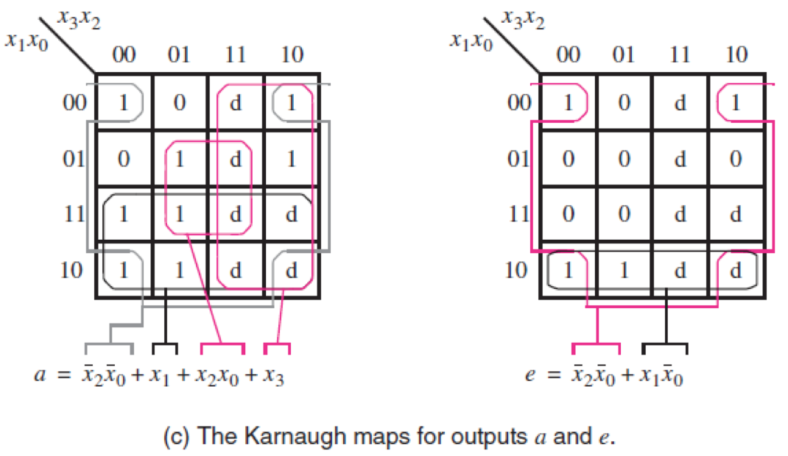
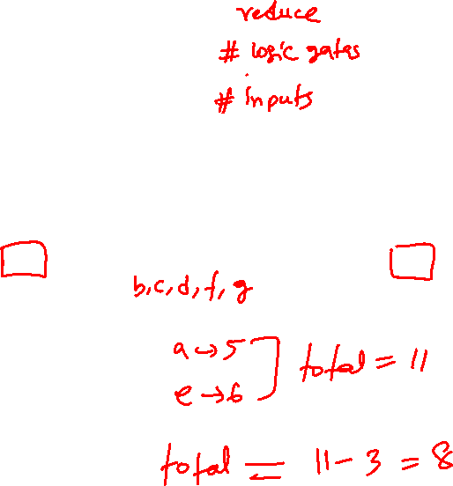
Seven-Segment Indicator

Slide 33
Another Example

Slide 34
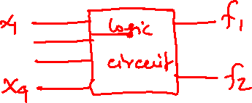
x
1
x
2
x
1
x
2
x
3
x
4
x
3
x
4
00
01
11
10
00
01
11
10
00
1
1
00
1
1
01
1
1
1
01
1
1
11
1
1
11
1
1
1
10
1
1
10
1
1
(a) Function
f
1
(b) Function
f
2
[ Figure 2.64 from the textbook ]

Slide 35
x
1
x
2
x
1
x
2
x
3
x
4
x
3
x
4
00
01
11
10
00
01
11
10
00
1
1
00
1
1
01
1
1
1
01
1
1
11
1
1
11
1
1
1
10
1
1
10
1
1
(a) Function
f
1
(b) Function
f
2
_
x₁ x₃

Slide 36
x
1
x
2
x
1
x
2
x
3
x
4
x
3
x
4
00
01
11
10
00
01
11
10
00
1
1
00
1
1
01
1
1
1
01
1
1
11
1
1
11
1
1
1
10
1
1
10
1
1
(a) Function
f
1
(b) Function
f
2
_
_
x₁ x₃
x₁ x₃

Slide 37
_
x
x
x
1
x
2
x₁ x₃
x
x
1
2
x
3
x
4
00
01
11
10
3
4
00
01
11
10
00
1
1
00
1
1
01
1
1
1
01
1
1
11
1
1
11
1
1
1
10
1
1
10
1
1
(a) Function
f
1
(b) Function
f
2
_
_
x₁ x₃
x₁ x₃

Slide 38
_
x
x
x
1
x
2
x₁ x₃
x
x
1
2
x
3
x
4
00
01
11
10
3
4
00
01
11
10
00
1
1
00
1
1
01
1
1
1
01
1
1
_
11
1
1
x₂ x₃ x₄
11
1
1
1
10
1
1
x₂ x₃ x₄
10
1
1
(a) Function
f
1
(b) Function
f
2
_
_
x₁ x₃
x₁ x₃

Slide 39
_
x
x
x
1
x
2
x₁ x₃
x
x
1
2
x
3
x
4
00
01
11
10
3
4
00
01
11
10
00
1
1
00
1
1
01
1
1
1
01
1
1
_
11
1
1
x₂ x₃ x₄
11
1
1
1
10
1
1
x₂ x₃ x₄
10
1
1
(a) Function
f
1
(b) Function
f
2
_
x
2
x
3
_
x₁ x₃
x
4
x₁ x₃
f
1
x
1
x
3
x
1
x
3
x
f
2
2
x
3
x
4
(c) Combined circuit for
f
1
and
f
2

Slide 40

_
x
x
x
1
x
2
x₁ x₃
x
x
1
2
x
3
x
4
00
01
11
10
3
4
00
01
11
10
00
1
1
00
1
1
01
1
1
1
01
1
1
_
11
1
1
x₂ x₃ x₄
11
1
1
1
10
1
1
x₂ x₃ x₄
10
1
1
(a) Function
f
1
(b) Function
f
2
_
x
2
x
3
_
x₁ x₃
x
4
x₁ x₃
f
1
x
1
x
3
x
1
x
3
x
f
2
2
x
3
x
4
(c) Combined circuit for
f
1
and
f
2

Slide 41

_
x
x
x
1
x
2
x₁ x₃
x
x
1
2
x
3
x
4
00
01
11
10
3
4
00
01
11
10
00
1
1
00
1
1
01
1
1
1
01
1
1
_
11
1
1
x₂ x₃ x₄
11
1
1
1
10
1
1
x₂ x₃ x₄
10
1
1
(a) Function
f
1
(b) Function
f
2
_
x
2
x
3
_
x₁ x₃
x
4
x₁ x₃
f
1
x
1
x
3
x
1
x
3
x
f
2
2
x
3
x
4
(c) Combined circuit for
f
1
and
f
2

Slide 42
_
x
x
x
1
x
2
x₁ x₃
x
x
1
2
x
3
x
4
00
01
11
10
3
4
00
01
11
10
00
1
1
00
1
1
01
1
1
1
01
1
1
_
11
1
1
x₂ x₃ x₄
11
1
1
1
10
1
1
x₂ x₃ x₄
10
1
1
(a) Function
f
1
(b) Function
f
2
_
x
2
x
3
_
x₁ x₃
x
4
x₁ x₃
f
1
x
1
x
3
x
1
x
3
x
f
2
2
x
3
x
4
(c) Combined circuit for
f
1
and
f
2

Slide 43
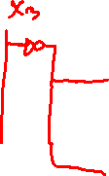
_
x
x
x
1
x
2
x₁ x₃
x
x
1
2
x
3
x
4
00
01
11
10
3
4
00
01
11
10
00
1
1
00
1
1
01
1
1
1
01
1
1
_
11
1
1
x₂ x₃ x₄
11
1
1
1
10
1
1
x₂ x₃ x₄
10
1
1
(a) Function
f
1
(b) Function
f
2
_
x
2
x
3
_
x₁ x₃
x
4
x₁ x₃
f
1
x
1
x
3
x
1
x
3
x
f
2
2
x
3
x
4
(c) Combined circuit for
f
1
and
f
2

Slide 44
x
1
x
2
x
1
x
2
x
3
x
4
x
3
x
4
00
01
11
10
00
01
11
10
00
1
1
00
1
1
01
1
1
1
01
1
1
11
1
1
11
1
1
1
10
1
1
10
1
1
(a) Function
f
1
(b) Function
f
2
x
2
x
3
x
4
f
1
x
1
x
3
x
1
x
3
x
f
2
2
x
3
x
4
(c) Combined circuit for
f
1
and
f
2
[ Figure 2.64 from the textbook ]

Slide 45
Yet Another Example

Slide 46
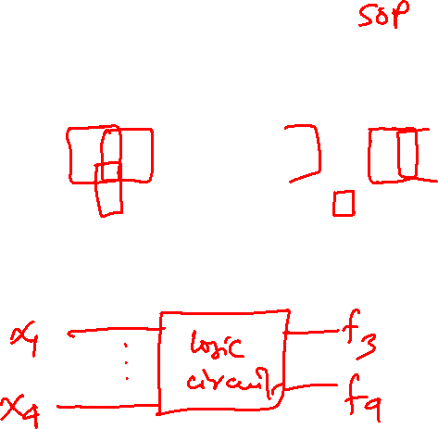
Individual vs Joint Optimization
x
1
x
2
x
1
x
2
x
3
x
4
00
01
11
10
x
3
x
4
00
01
11
10
00
00
01
1
1
1
01
1
1
1
11
1
1
1
11
1
1
1
10
1
10
1
(a) Optimal realization of
f
3
(b) Optimal realization of
f
4
[ Figure 2.65 from the textbook ]

Slide 47
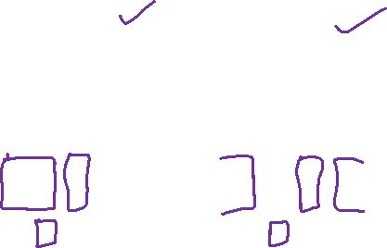
Individual vs Joint Optimization
x
1
x
2
x
1
x
2
x
3
x
4
00
01
11
10
x
3
x
4
00
01
11
10
00
00
01
1
1
1
01
1
1
1
11
1
1
1
11
1
1
1
10
1
10
1
(a) Optimal realization of
f
3
(b) Optimal realization of
f
4
x
1
x
2
x
1
x
2
x
3
x
4
00
01
11
10
x
3
x
4
00
01
11
10
00
00
01
1
1
1
01
1
1
1
11
1
1
1
11
1
1
1
10
1
10
1
(c) Optimal realization of
f
3
and
f
4
together
[ Figure 2.65 from the textbook ]

Slide 48
Individual vs Joint Optimization
x
1
x
2
x
1
x
2
x
3
x
4
00
01
11
10
x
3
x
4
00
01
11
10
00
00
01
1
1
1
01
1
1
1
11
1
1
1
11
1
1
1
10
1
10
1
(a) Optimal realization of
f
3
(b) Optimal realization of
f
4
x
1
x
2
x
1
x
2
x
3
x
4
00
01
11
10
x
3
x
4
00
01
11
10
00
00
01
1
1
1
01
1
1
1
11
1
1
1
11
1
1
1
10
1
10
1
(c) Optimal realization of
f
3
and
f
4
together
[ Figure 2.65 from the textbook ]

Slide 49

Individual vs Joint Optimization
x
1
x
2
x
1
x
2
x
3
x
4
00
01
11
10
x
3
x
4
00
01
11
10
00
00
01
1
1
1
01
1
1
1
11
1
1
1
11
1
1
1
10
1
10
1
(c) Optimal realization of
f
3
and
f
4
together
x
1
x
4
x
1
f
3
x
2
x
4
x
1
x
2
x
3
x
4
f
4
x
2
x
4
(d) Combined circuit for
f
3
and
f
4
[ Figure 2.65 from the textbook ]

Slide 50
Individual vs Joint Optimization
x
1
x
2
x
1
x
2
x
3
x
4
00
01
11
10
x
3
x
4
00
01
11
10
00
00
01
1
1
1
01
1
1
1
11
1
1
1
11
1
1
1
10
1
10
1
(c) Optimal realization of
f
3
and
f
4
together
x
1
x
4
x
1
f
3
x
2
x
4
x
1
x
2
x
3
x
4
f
4
x
2
x
4
(d) Combined circuit for
f
3
and
f
4
[ Figure 2.65 from the textbook ]

Slide 51
Individual vs Joint Optimization
x
1
x
2
x
1
x
2
x
3
x
4
00
01
11
10
x
3
x
4
00
01
11
10
00
00
01
1
1
1
01
1
1
1
11
1
1
1
11
1
1
1
10
1
10
1
(c) Optimal realization of
f
3
and
f
4
together
x
1
x
4
x
1
f
3
x
2
x
4
x
1
x
2
x
3
x
4
f
4
x
2
x
4
(d) Combined circuit for
f
3
and
f
4
[ Figure 2.65 from the textbook ]

Slide 52
Yet Another Example

Slide 53

Individual vs Joint Optimization
x
x
x1
x2
x
3
x
4
1
2
x
3
x
4
00
01
11
10
00
01
11
10
00
00
01
01
11
11
10
10
(a) Optimal realization of
f
1
(b) Optimal realization of
f
2
x
x
x1
x2
x
3
x
4
1
2
x
3
x
4
00
01
11
10
00
01
11
10
00
00
01
01
11
11
10
10
(a) Optimal realization of
f
1
(b) Optimal realization of
f
2
[ Figure 2.65 from the textbook ]

Slide 54








Individual vs Joint Optimization
x
1
x
2
x
x
X1
x2
x
3
x
4
00
01
11
10
3
4
00
01
11
10
00
00
01
01
11
11
10
10
(a) Optimal realization of
f
1
(b) Optimal realization of
f
2
[ Figure 2.65 from the textbook ]

Slide 55









Individual vs Joint Optimization
x
1
x
2
x
x
X1
x2
x
3
x
4
00
01
11
10
3
4
00
01
11
10
00
00
01
01
11
11
10
10
(a) Optimal realization of
f
1
(b) Optimal realization of
f
2
[ Figure 2.65 from the textbook ]

Slide 56
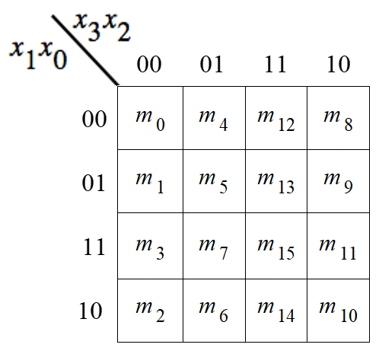

Lec 11: Test Q1
f(x₃, x₂, x₁, x₀) = Σ m(2, 4, 10) + D(6, 7, 12, 13, 14, 15)
x
3
x
2
x
1
x
0
00
01
11
10
00
01
11
10
x
3
x
2
x
1
x
0
00
01
11
10
00
01
11
10

Slide 57

Incompletely Specified Function: SOP vs POS
f(x₃, x₂, x₁, x₀) = Σ m(2, 4, 10) + D(6, 7, 12, 13, 14, 15)
x
3
x
2
x
1
x
0
00
01
11
10
00
01
11
10
x
3
x
2
x
1
x
0
00
01
11
10
00
01
11
10

Slide 58





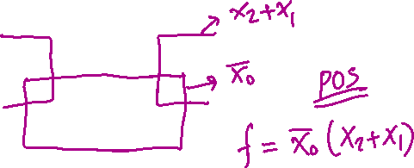
Incompletely Specified Function: SOP vs POS
f(x₃, x₂, x₁, x₀) = Σ m(2, 4, 10) + D(6, 7, 12, 13, 14, 15)
x
3
x
2
x
1
x
0
00
01
11
10
00
01
11
10
x
3
x
2
x
1
x
0
00
01
11
10
00
01
11
10

Slide 59

END Slide

